Slide 1
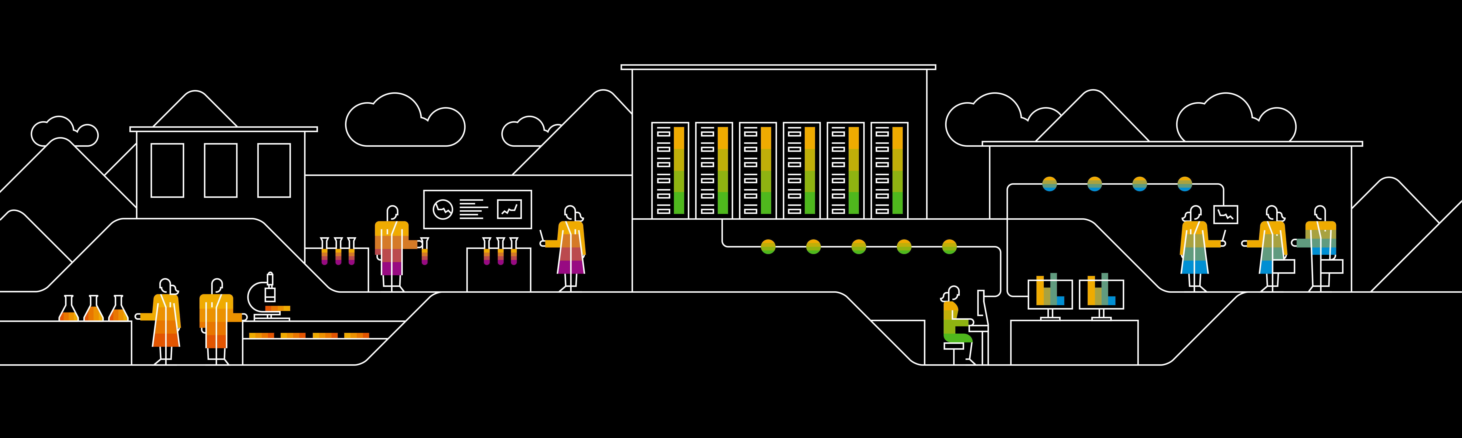
Introduction to Machine Learning Curriculum

Slide 2
Agenda
Overview
Data Science
Machine Learning
Supervised Learning
Un-Supervised Learning
Reinforcement Learning
Deep Learning
Artificial Intelligence

Slide 3
Overview
Artific
Artificial Intelligence
Machine Learning
Data Science
Deep Learning
Image 1

Slide 4
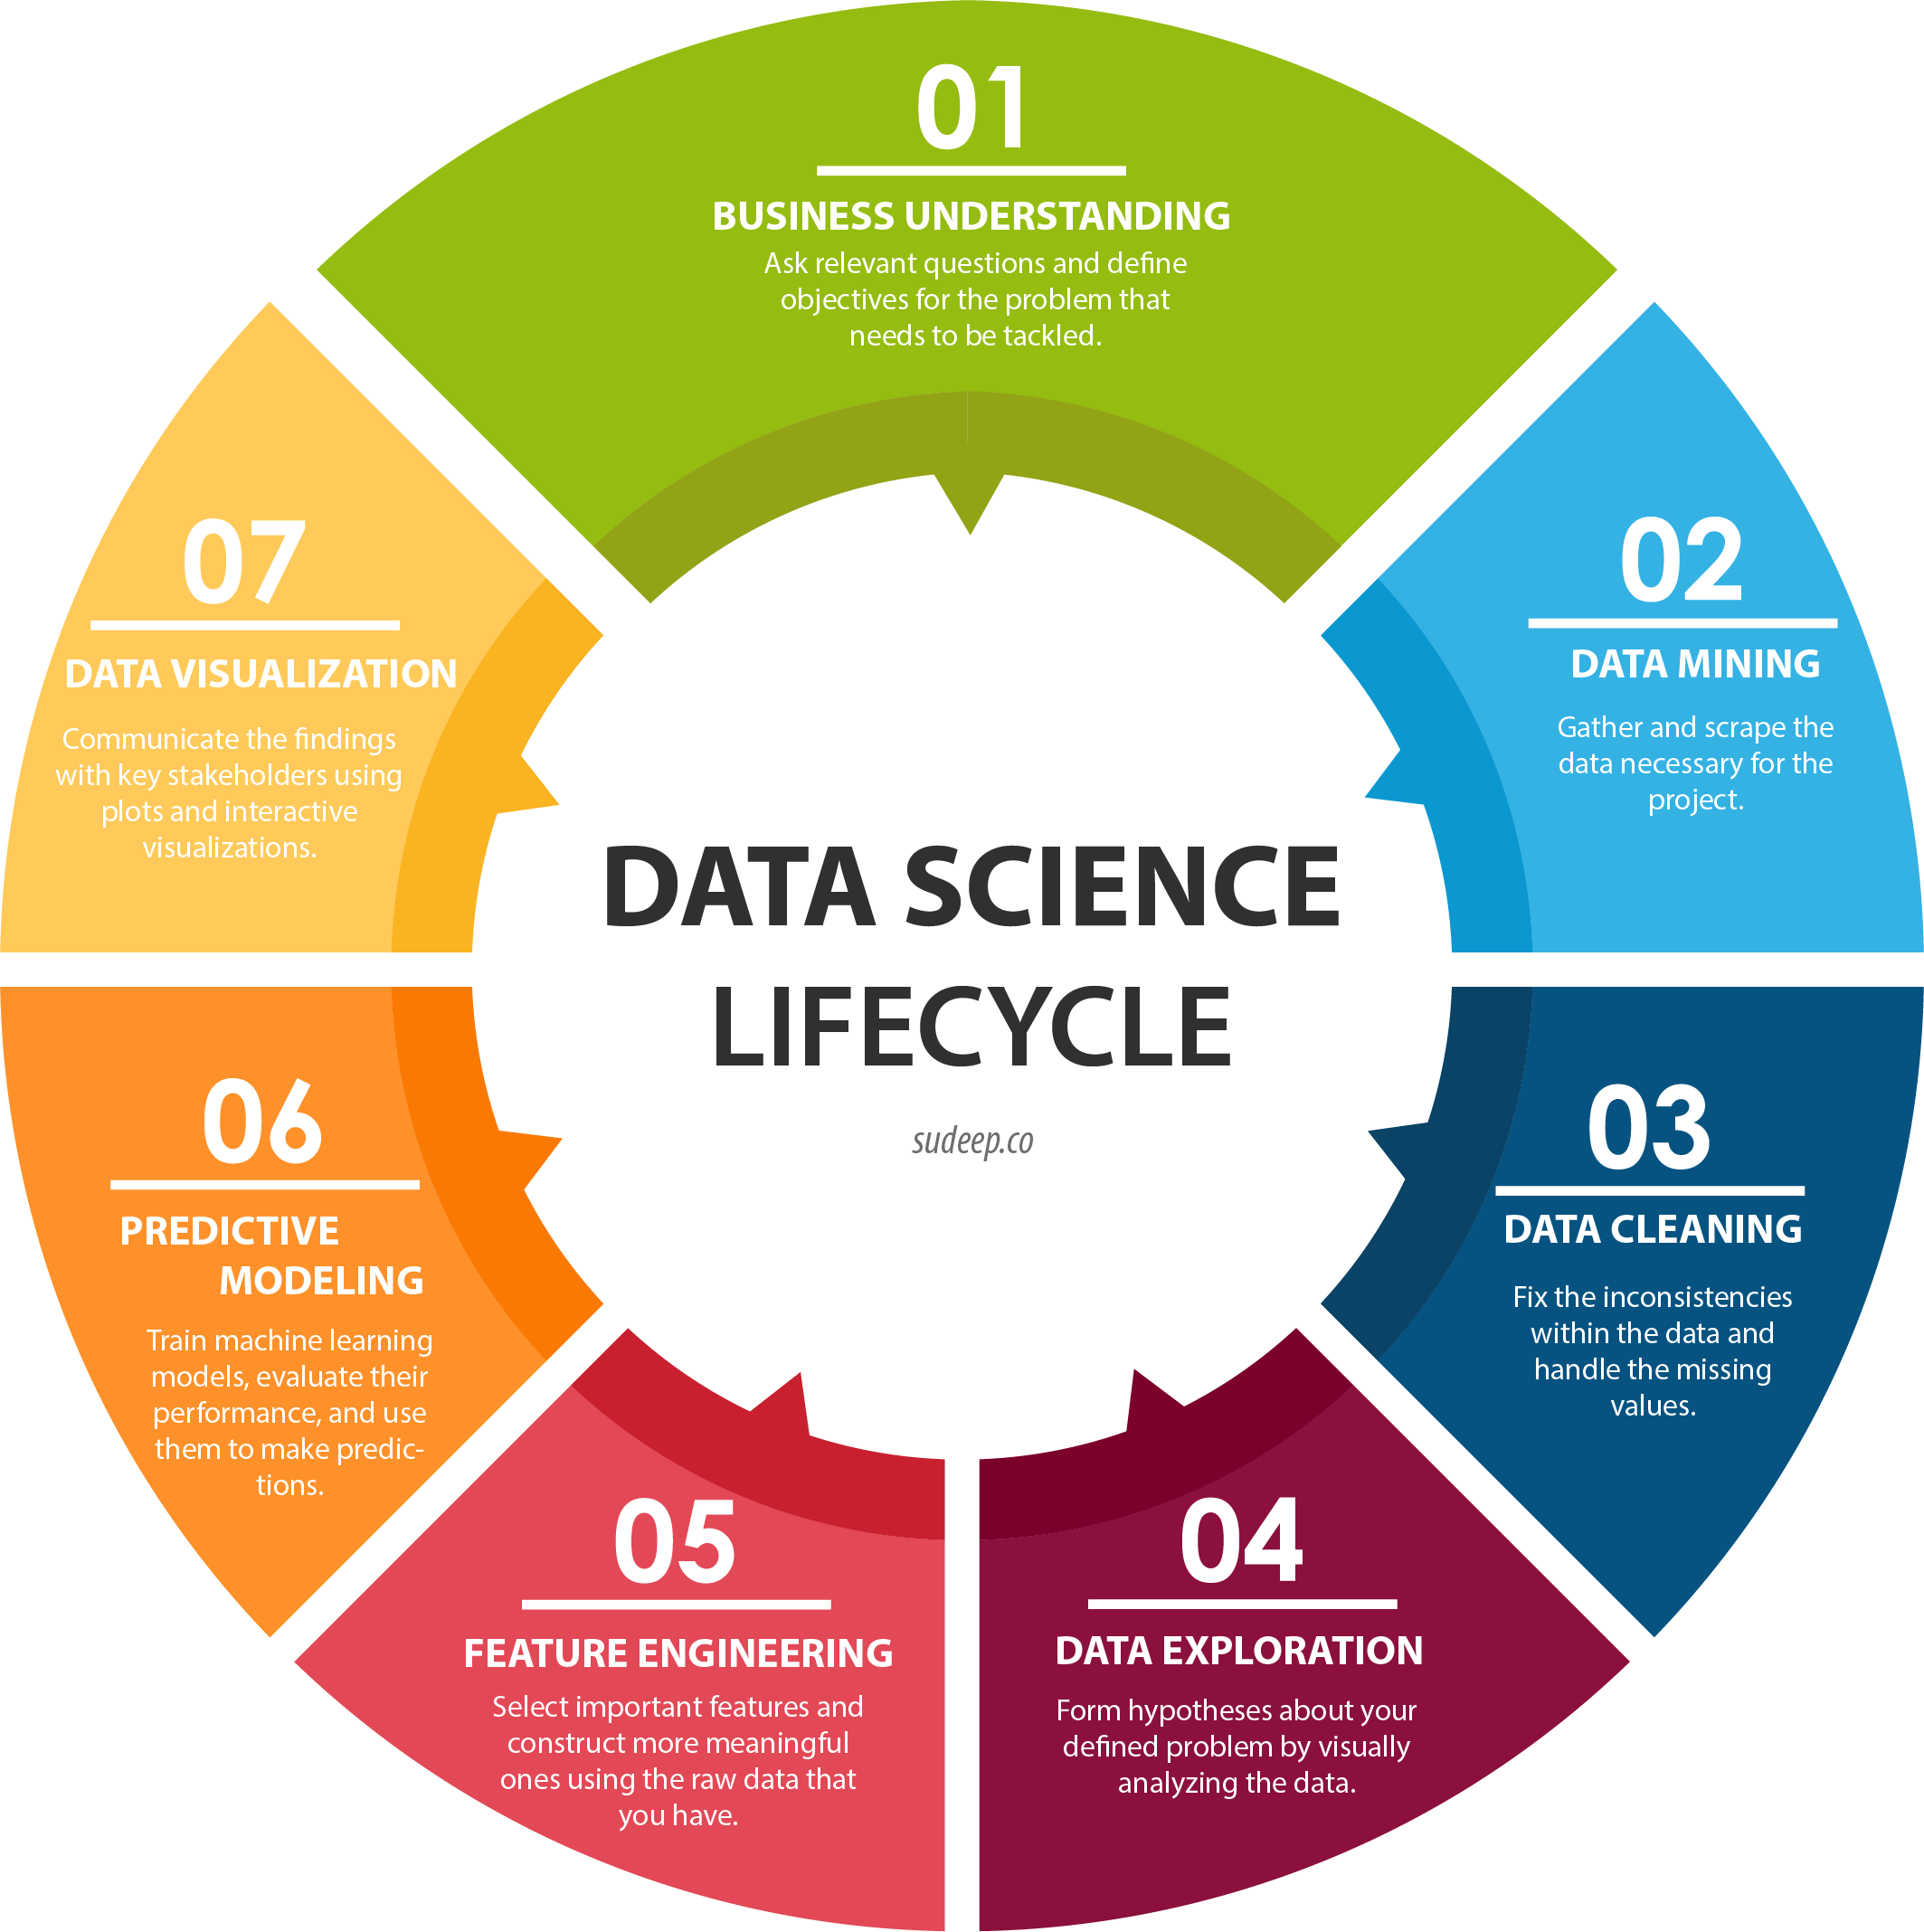
Data Science
The art of uncovering the insights and trends in data has been around since ancient times.
The ancient Egyptians used census data to increase efficiency in tax collection and they accurately predicted the flooding of the Nile river every year.
Data Science is a blend of various tools, algorithms, and machine learning principles with the goal to discover hidden patterns from the raw data.
Image 7

Slide 5
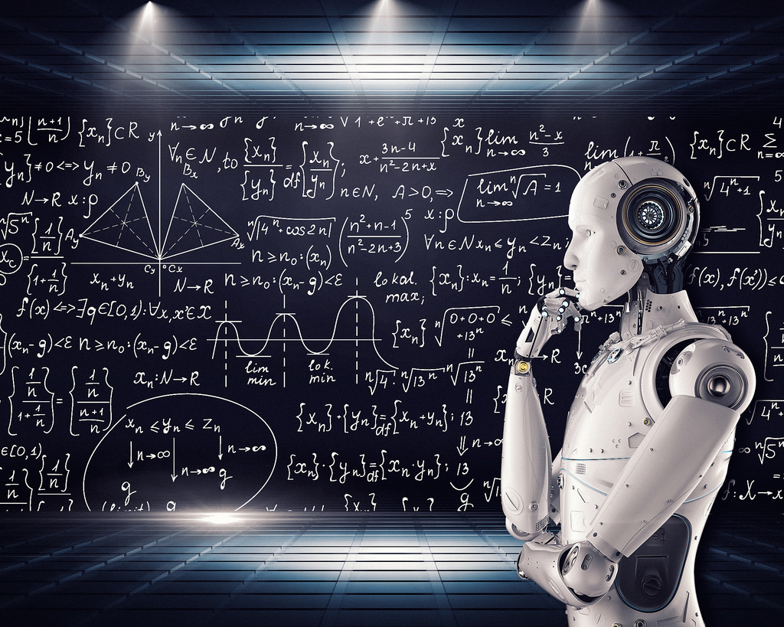
Machine Learning
Machine learning is an application of artificial intelligence (AI) that provides systems the ability to automatically learn and improve from experience without being explicitly programmed. Machine learning focuses on the development of computer programs that can access data and use it learn for themselves.
Types of Machine Learning:
Supervised Machine Learning
Unsupervised Machine Learning
Reinforcement Machine Learning
Image 2

Slide 6
Internal
Types in ML
Machine Learning
Supervised learning
Unsupervised Learning
Association
Clustering
Regression
Classification
Reinforcement learning
Deep Q Networks

Slide 7
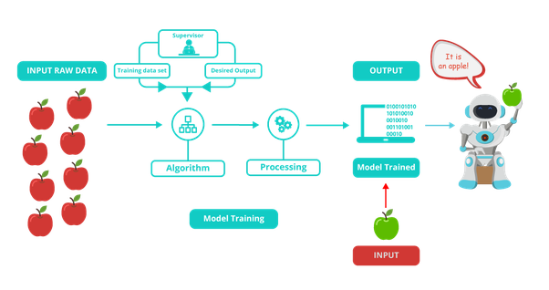
Supervised Learning
Image 3

Slide 8
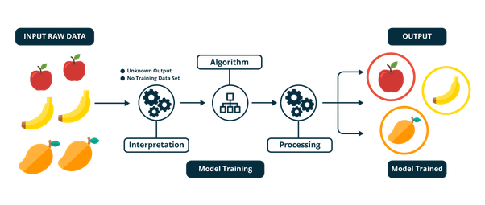
Unsupervised Learning
Image 4

Slide 9
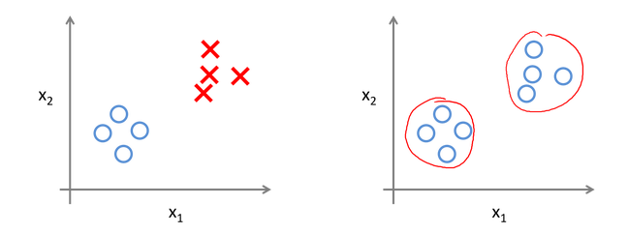
Supervised vs Unsupervised
Image 5

Slide 10
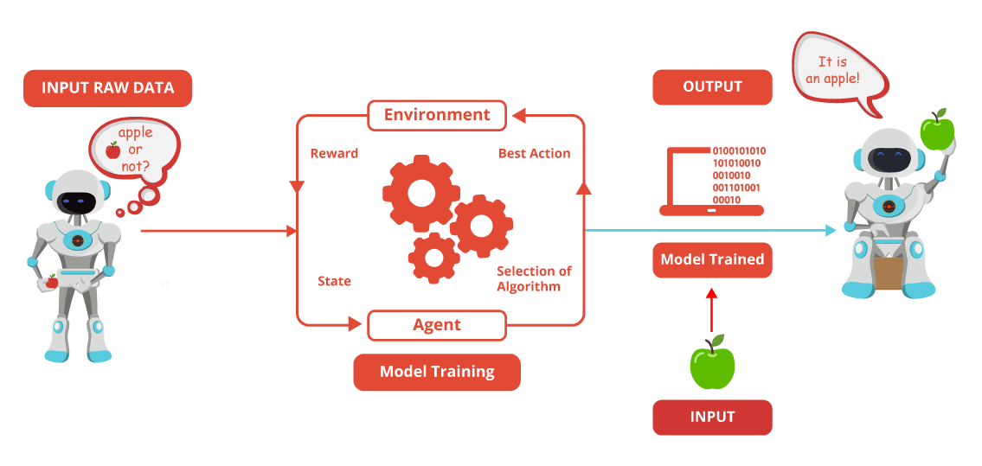
Reinforcement Learning
Image 6

Slide 11
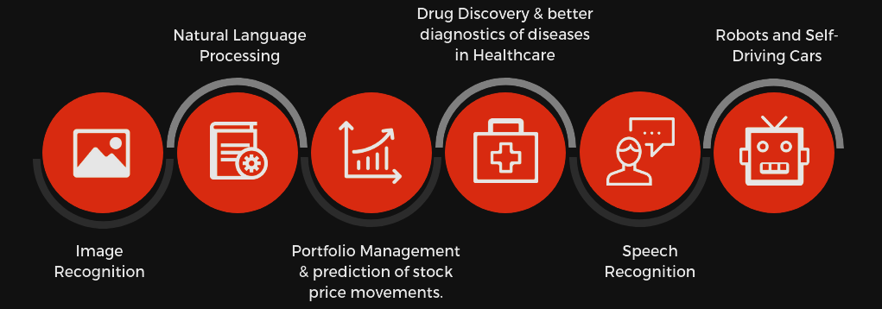
Deep Learning
Deep Learning is a subfield of machine learning concerned with algorithms inspired by the structure and function of the brain called artificial neural networks.
Both machine and deep learning are subsets of artificial intelligence, but deep learning represents the next evolution of machine learning. In machine learning, algorithms created by human programmers are responsible for parsing and learning from the data. They make decisions based on what they learn from the data. Deep learning learns through an artificial neural network that acts very much like a human brain and allows the machine to analyze data in a structure very much as humans do.
Image 8

Slide 12
Artificial Intelligence
Artificial intelligence is the simulation of human intelligence processes by machines, especially computer systems. These processes include learning (the acquisition of information and rules for using the information), reasoning (using rules to reach approximate or definite conclusions) and self-correction
Some examples of AI:
IBM Watson
Microsoft Cognitive Services
Google AI
Amazon AI

Slide 13
Conclusion
DATA SCIENCE
MACHINE
LEARNING
DEEP
LEARNING
ARTIFICIAL
INTELLIGENCE
Data Science is a concept used to tackle big data and includes data cleansing, preparation, and analysis.
Machine Learning is defined as the practice of using algorithms to use data, learn from it and then forecast future trends for that topic.
Deep learning is a machine learning technique that teaches computers to do what comes naturally to humans: learn by example.
Machines that mimic "cognitive" functions that humans associate with other human minds, such as "learning" and "problem solving"

Slide 14
Thank you.

Slide 15
References
Image 2
Image 3
Image 4
Image 5
Image 6
Image 7
Image 8

